Slide 1


Slide 2







TEAM 6
Kamalika Das
Amisha Turkel
Akshay Deshmukh
Mahima Kriplani
Chief Executive
Officer
Chief Marketing
Officer
Chief Financial
Officer
Chief Technical
Officer

Slide 3




AGENDA
Executive Summary
Product: What & Why
Market Size
& STP
Revenue
Model
Sales
Analysis
Prototype
Demo

Slide 4
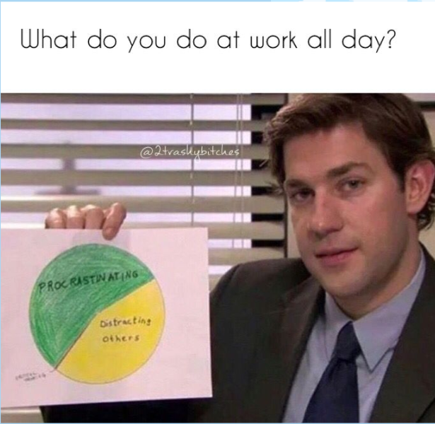
Is this you?

Slide 5
EXECUTIVE SUMMARY
Business Objective
Level up! An extension line for team efforts towards productivity.
METHODOLOGY
Features of incentive, gamification, affiliate, marketing and tracking progress.
OUTCOMES
Tapping unmet customer need , business expansion , increased revenue.

Slide 6

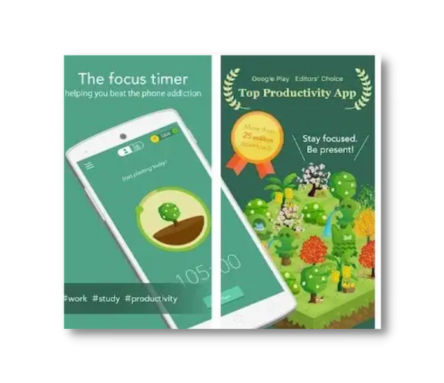
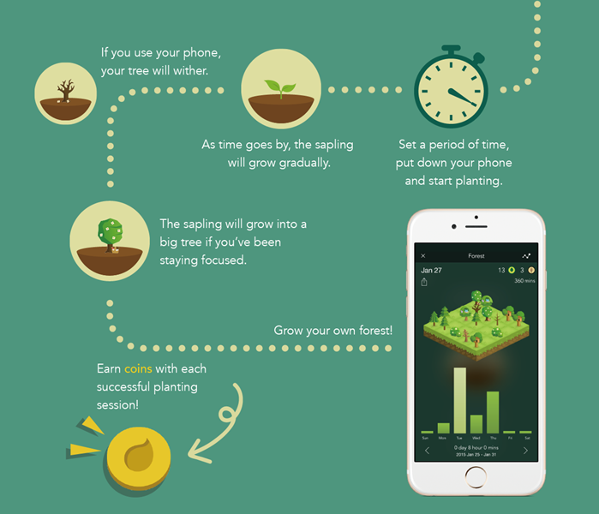
Product
Forest: Productivity app, beat procrastination by rewarding user for staying away from phone.
Reduces mobile addiction
Improves mindfullness
Deep focus
Sense of achievement
Environment Hero
Track session and progress in-app purchases

Slide 7
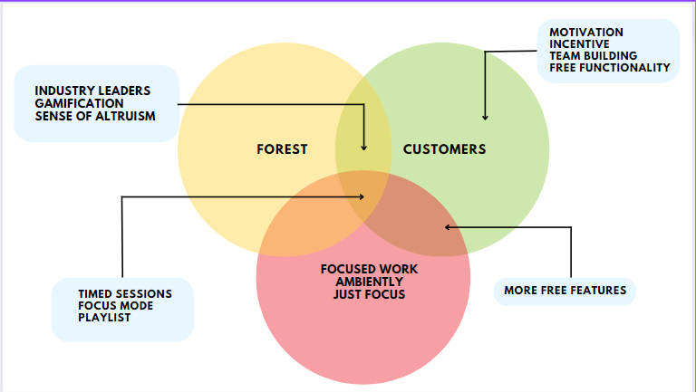

Company Standing

Slide 8





Branch Out!
MOTIVATION
TEAM EFFORT
FEATURES
Inspirational playlist- Ted Talk, stimulation music,
short motivational clips
Accountability on one and each, team's drive induces motivation
Leaderboard status, time tracker, progress visuals,
reflection

Slide 9




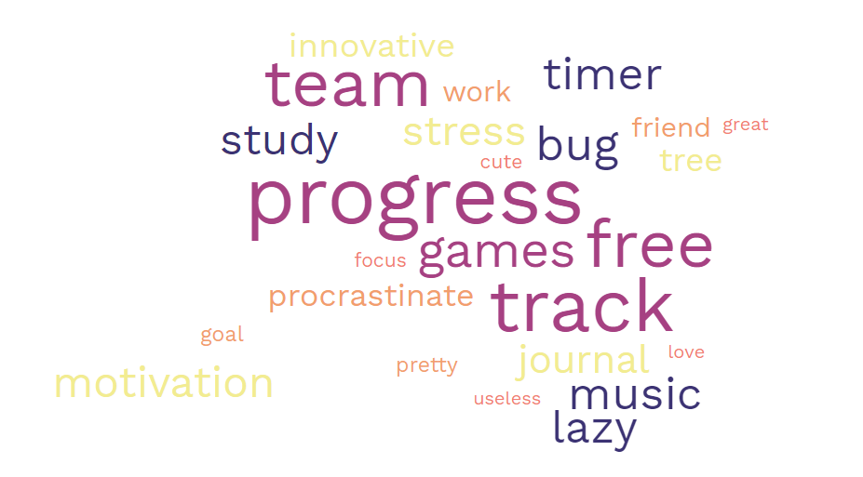
Know your Audience
25 MILLION
DOWNLOADS
2 MILLION SATISFIED PAYING USERS

Slide 10

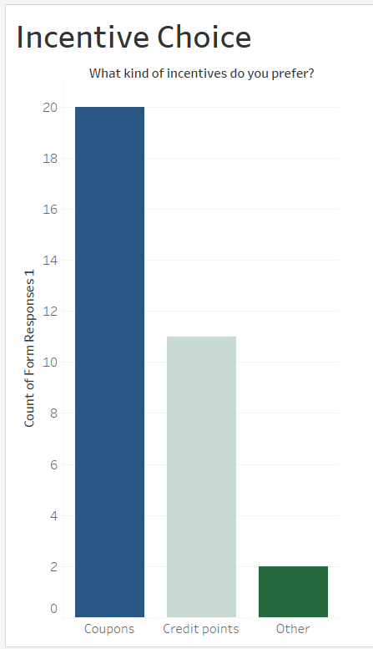
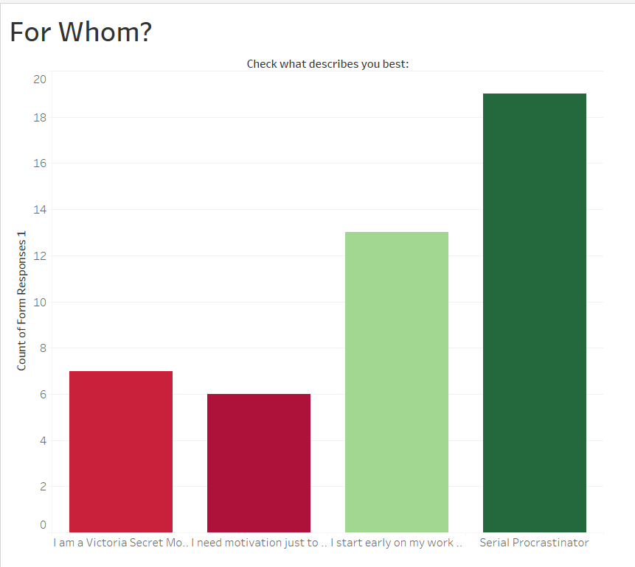
Sample Check

Slide 11
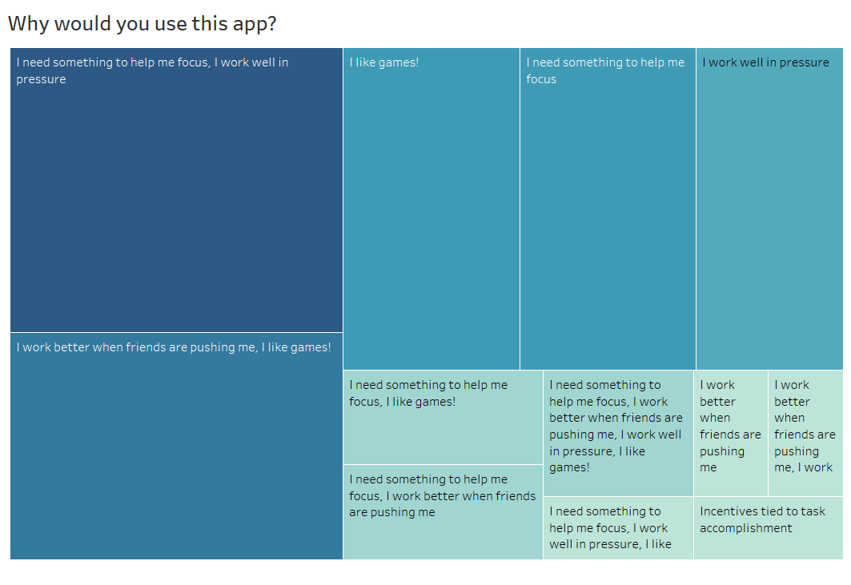
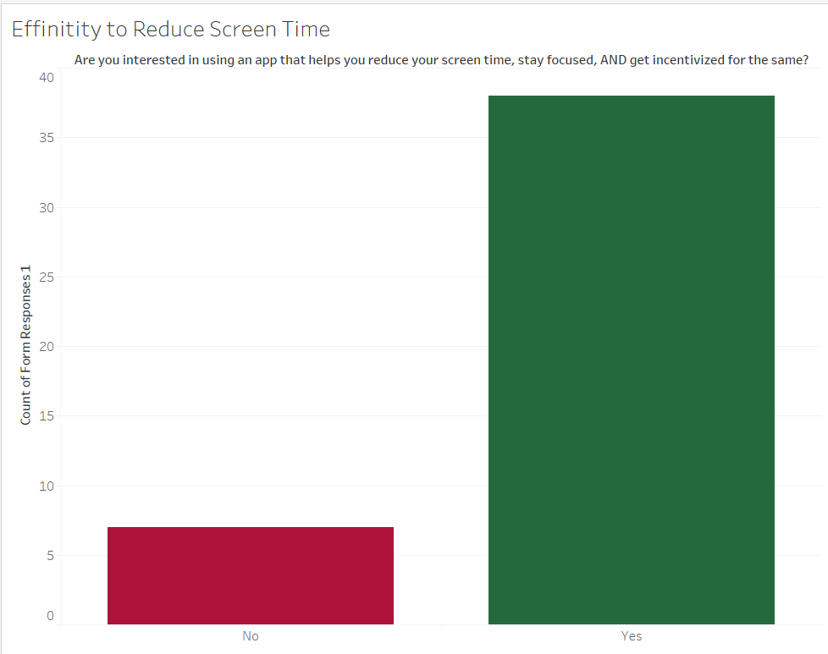
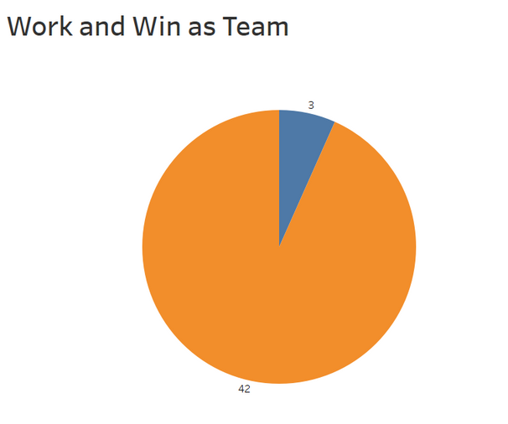
Survey Sentiments

Slide 12

Know yourself
STRENGTH | WEAKNESS | OPPORTUNITY | THREAT
Incentive based mechanisms will help motivate more users to try it. | Need to collectively agree on incentive | The penetration to the B2B landscape can prove to be profitable. | Easily replicable business model
Promotes team collaboration and stronger work ethics. | Builds a competitive landscape if not moderated well | Further scope to target parents of younger children to help them keep a watch | Larger players in the app development market can easily take over the business idea, since no patent
Helpful to manage remote teams | Ads in the app counterintuitive to the idea of helping people stay focused.

Slide 13
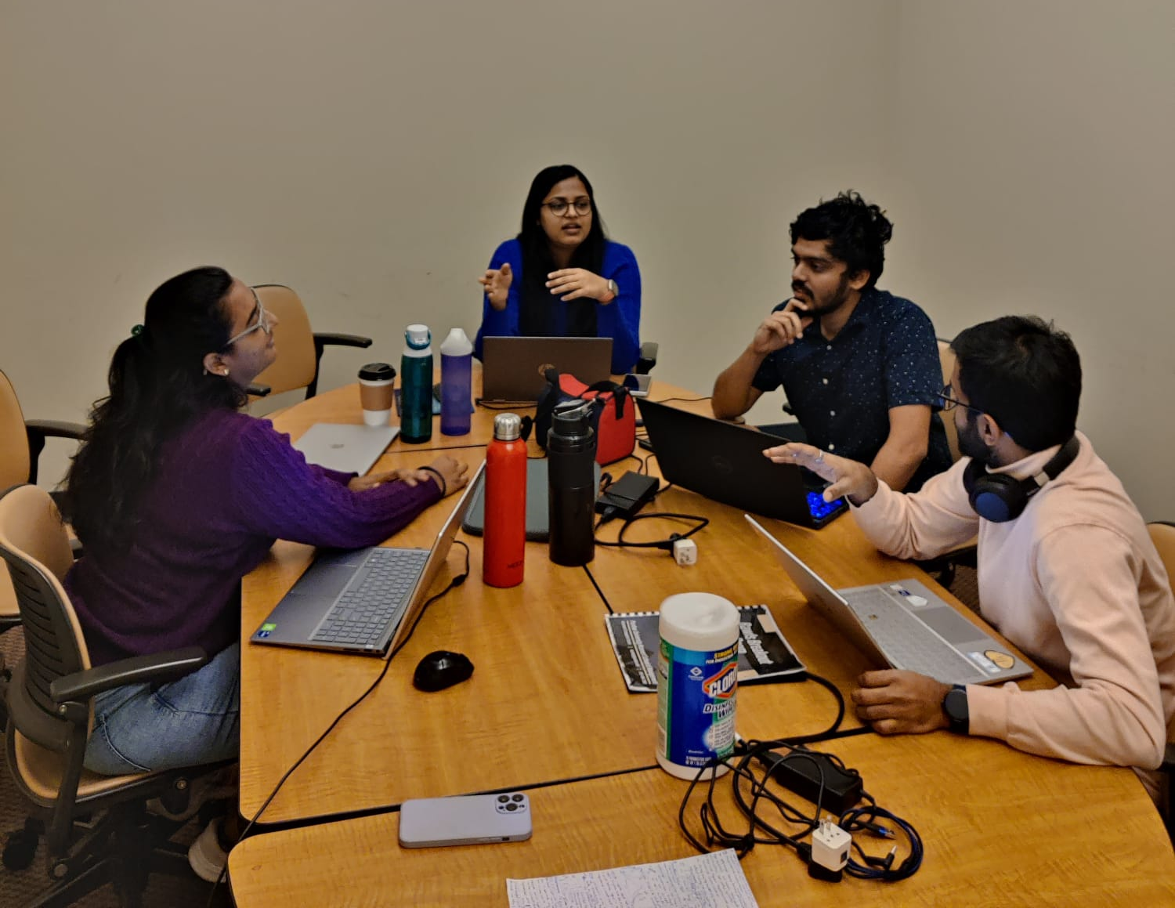
Focus Group
Activity performed with the Focus Group
Introduction of the app and explained key features
Showed demo of the LevelUP App interface
Highlighted new features that Level Up is offering
Asked them to try the interface
Collected Feedback
Feedback received from the Focus Group
Add a To-do list feature
Provide ccess to a community of like-minded users who can offer support and encouragement

Slide 14


Competitors in the Market
Apps | Build a Community | Pomodoro Technique | Blocks websites | Progress Tracking ​ | Reminders | Flash Cards
Level UP! | ​ | ​ | ​ | ​ | ​
Forest | ​ | ​ | ​ | ​ | ​
Cold Turkey | ​ | ​ | ​ | ​ | ​
Study Buddy | ​ | ​ | ​ | ​ | ​

Slide 15
4 P’s of Marketing
Product
Profitability
Gamification
Reward points
Community
Todo List
Progress tracker
Premium Subscription
Targeted advertisements
Sell in app purchases such as stickers
Place
Promotion
Smartphones / Tablets
IoS / Android / Windows
Play Store / App Store
Website
Blogs
Social media accounts
Productivity related conference

Slide 16

Segmentation – Targeting - Positioning
Partnerships with schools, professional organizations, trade associations, or networking groups.
Promote app's goal settings and progress tracking features.
Highlight the feature of creating study groups, conduct innovation challenge competitions.
Can be positioned as an app that provides help practice self-restraint through its incentive-based mechanism.
Students
Professionals
Individuals with specific goals / objectives
Individuals interested in self-improvement.

Slide 17
Pricing
Priced comparable to Forest app at $4
Better features at same cost
Low enough for college students to afford
High enough to reach breakeven point

Slide 18
Costs (1/2)
Operations moved overseas to keep costs lower
Development cost is estimated to be $253,440
The yearly recurring cost is estimated to be $253,440
Costs are based on research we performed

Slide 19
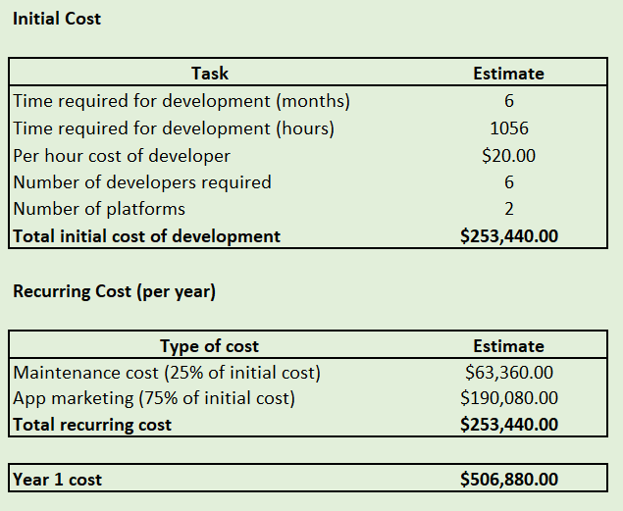
Costs (2/2)

Slide 20
Revenue Model (1/2)
Initial downloads estimated to be 240,000 based on the target market and market share –
College students
Working professionals
Revenue from 3 sources –
Sales revenue - $96,000
In-app advertisement - $78,840
Data monetization - $72,000
Year 1 revenue - $246,840

Slide 21
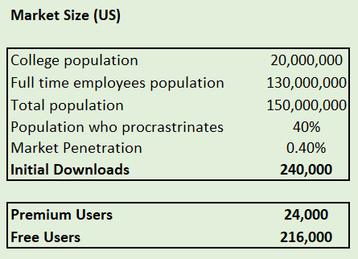
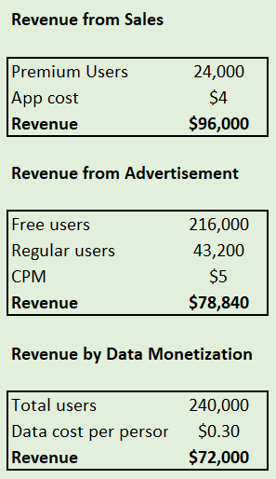
Revenue Model (2/2)

Slide 22
Sales Forecast & Breakeven (1/2)
Year 1 revenue - $246,840
CAGR for revenue growth at 12%
Recurring costs unchanged as technology gets cheaper with time
Breakeven point at Year 5

Slide 23
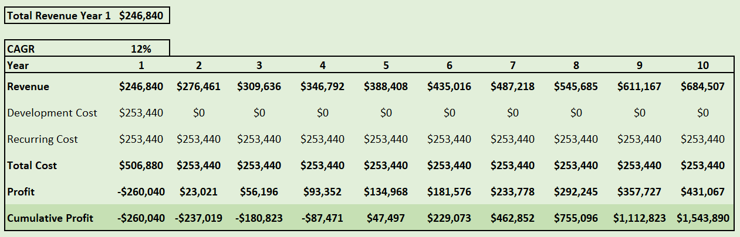
Sales Forecast & Breakeven (2/2)

Slide 24
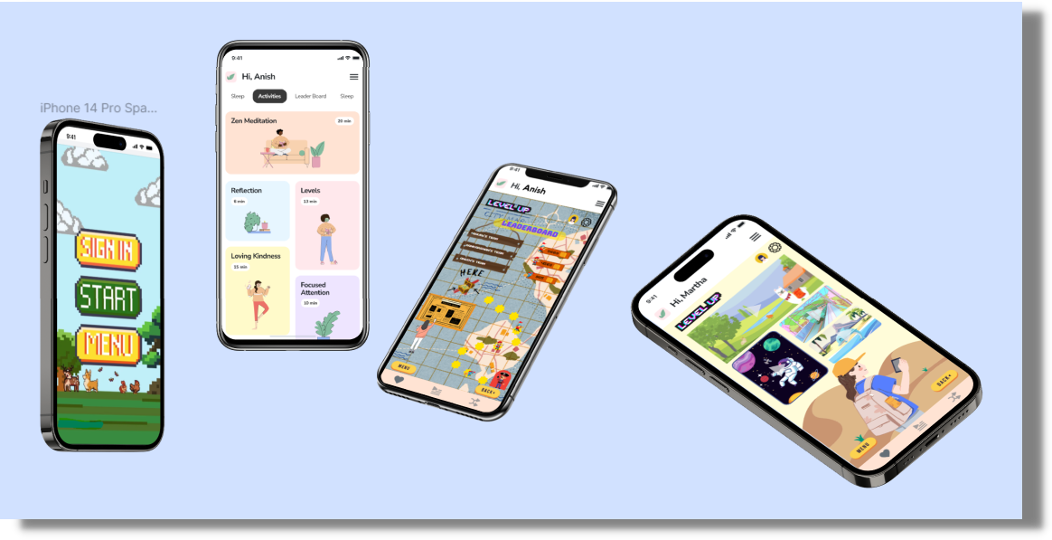
Prototype Demo

Slide 25



Slide 26







Leaderboard
11:11
Overview
Know team performance in comparison to others
Day
Week
Month
Year
<
December
>
Incentive Compatible
Meditation
15.2%
Rewards for level completion, adding more people in the platform
Journal
9.1%
Assignment
37.9%
LeetCode
15.2%
Deep Focus
Study
22.7%
Disable select apps, notified on pomodoro-sessions
Team | Rank | Score
 | 1 | 2600
 | 3 | 895
Tracker
Visuals for tracking progress, performance and pattern analyzer features with in-app purchases

Slide 27
Thank you!
Let’s help each other!
Open for question.

Slide 28

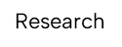


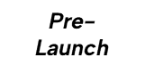







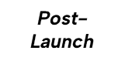

PRODUCT LAUNCH PLAN
Success Metric
Market analysis, Feasibility analysis and Competitor analysis
Hypothesis Testing
STP framework & Prototyping
Problem Validation
Beta test, Discover shortcomings
Users buy in on value
proposition.
Promote through websites, blogs, social media platforms.
Sales analysis, ROI
Introduce different versions for desktop / other devices.
New customers added,
sales ROI

